Slide 1
ITILv3 Introduction and Overview

Slide 2
Agenda for the Session
What is ITIL?
What about v3?
Key Concepts
Service Management & Delivery
The Service Lifecycle
The Five Stages of the lifecycle
ITIL Roles
Functions and Processes
Further Learning
Accreditation

Slide 3
What is ITIL?
Systematic approach to high quality IT service delivery
Documented best practice for IT Service Management
Provides common language with well-defined terms
Developed in 1980s by what is now The Office of Government Commerce
itSMF also involved in maintaining best practice documentation in ITIL
  itSMF is global, independent, not-for-profit

Slide 4
What about v3?
ITIL started in 80s.
  40 publications!
v2 came along in 2000-2002
  Still Large and complex
  8 Books
  Talks about what you should do
v3 in 2007
  Much simplified and rationalised to 5 books
  Much clearer guidance on how to provide service
  Easier, more modular accreditation paths
  Keeps tactical and operational guidance
  Gives more prominence to strategic ITIL guidance relevant to senior staff
  Aligned with ISO20000 standard for service management

Slide 5
Key Concepts
Service
  Delivers value to customer by facilitating outcomes customers want to achieve without ownership of the specific costs and risks
  e.g. The HFS backup service means that you as Unit ITSS don’t have to care about how much tapes, disks or robots cost and you don’t have to worry if one of the HFS staff is off sick or leaves

Slide 6
Key Concepts
Service Level
  Measured and reported achievement against one or more service level targets
  E.g.
    Red = 1 hour response 24/7
    Amber = 4 hour response 8/5
    Green = Next business day
Service Level Agreement
  Written and negotiated agreement between Service Provider and Customer documenting agreed service levels and costs

Slide 7
Key Concepts
Configuration Management System (CMS)
  Tools and databases to manage IT service provider’s configuration data
  Contains Configuration ManagementDatabase (CMDB)
    Records hardware, software, documentation and anything else important to IT provision
Release
  Collection of hardware, software, documentation, processes or other things require to implement one or more approved changes to IT Services

Slide 8
Key Concepts
Incident
  Unplanned interruption to an IT service or an unplanned reduction in its quality
Work-around
  Reducing or eliminating the impact of an incident without resolving it
Problem
  Unknown underlying cause of one or more incidents

Slide 9
4 Ps of Service Management
People – skills, training, communication
Processes – actions, activities, changes, goals
Products – tools, monitor, measure, improve
Partners – specialist suppliers

Slide 10
Service Delivery Strategies
Strategy | Features
In-sourcing | All parts internal
Out-sourcing | External resources for specific and defined areas (e.g. Contract cleaners)
Co-Sourcing | Mixture of internal and external resources
Knowledge Process Outsourcing (domain-based business expertise) | Outsourcing of particular processes, with additional expertise from provider
Application Outsourcing | External hosting on shared computers – applications on demand (e.g. Survey Monkey, Meet-o-matic)
Business Process Outsourcing | Outsourcing of specific processes e.g. HR, Library Circulation, Payroll
Partnership/Multi-sourcing | Sharing service provision over the lifecycle with two or more organisations (e.g. Shared IT Corpus/Oriel)

Slide 11
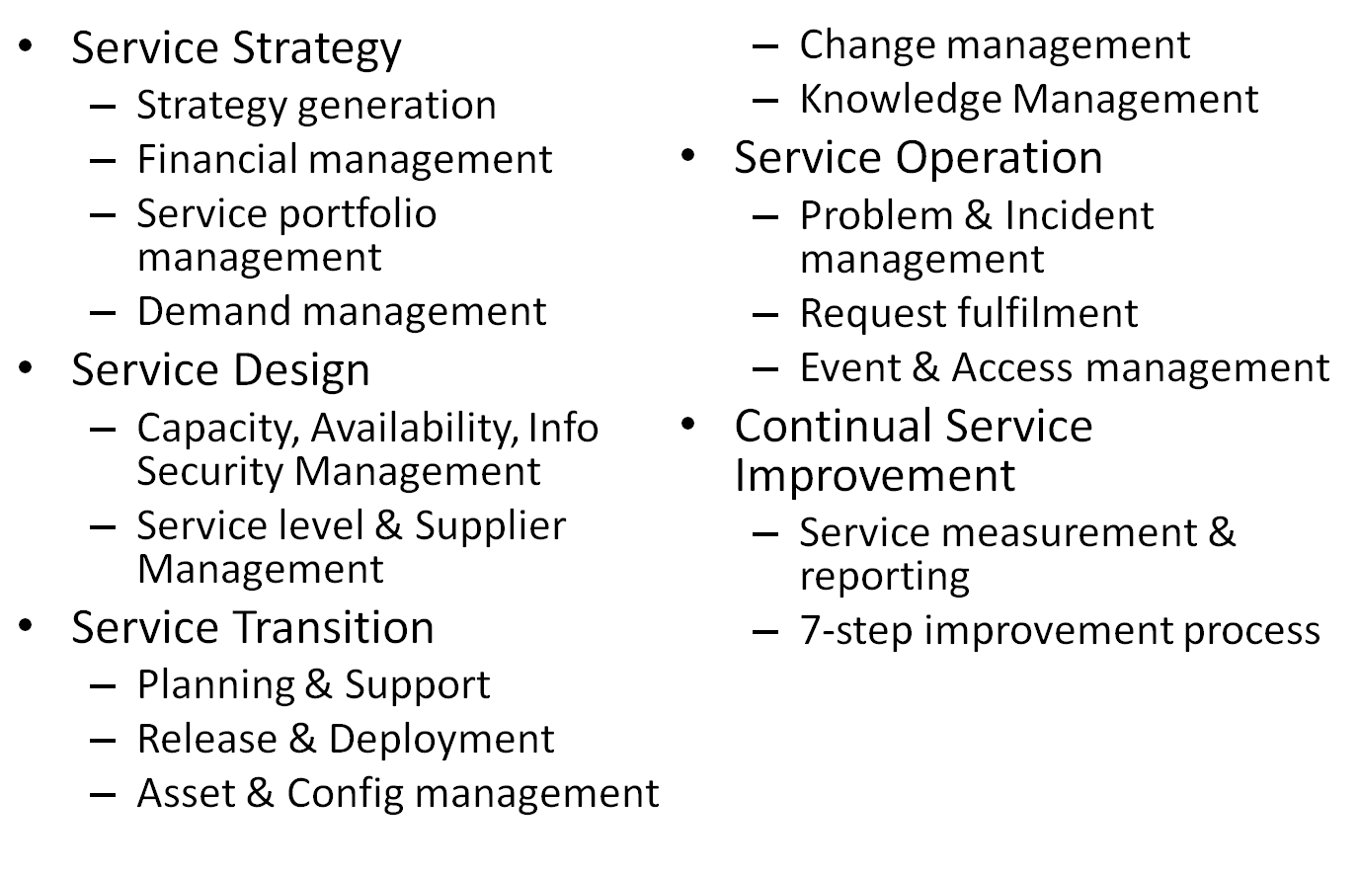
The Service Lifecycle

Slide 12
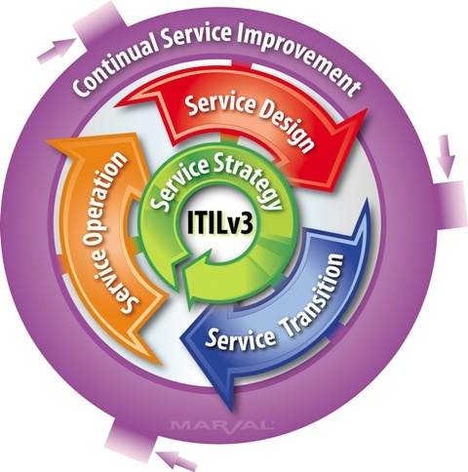
How the Lifecycle stages fit together

Slide 13
Service Strategy
What are we going to provide?
Can we afford it?
Can we provide enough of it?
How do we gain competitive advantage?
Perspective
  Vision, mission and strategic goals
Position
Plan
Pattern
  Must fit organisational culture

Slide 14
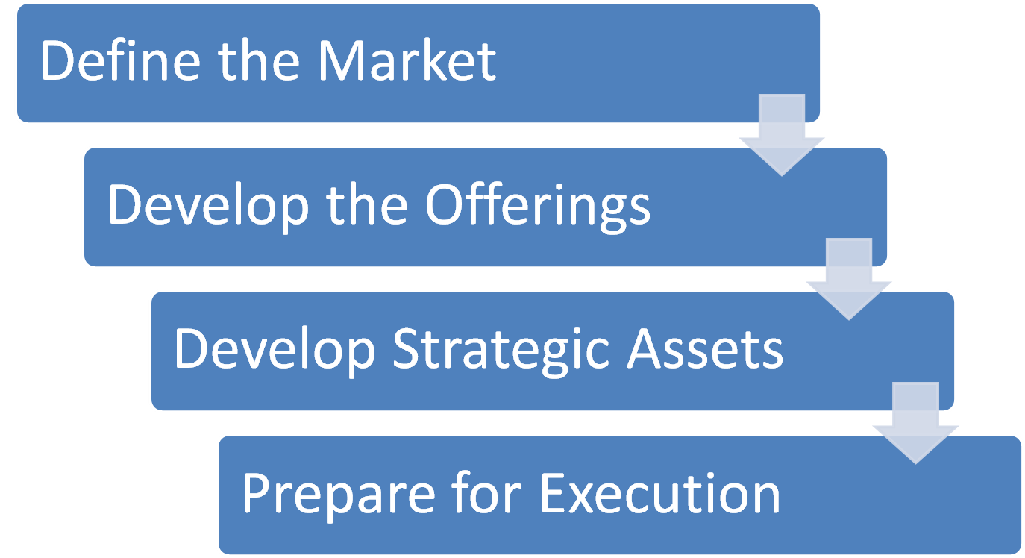
Service Strategy has four activities

Slide 15
Service Assets
Resources
  Things you buy or pay for
  IT Infrastructure, people, money
  Tangible Assets
Capabilities
  Things you grow
  Ability to carry out an activity
  Intangible assets
  Transform resources into Services

Slide 16
Service Portfolio Management
Prioritises and manages investments and resource allocation
Proposed services are properly assessed
  Business Case
Existing Services Assessed. Outcomes:
  Replace
  Rationalise
  Renew
  Retire

Slide 17
Demand Management
Ensures we don’t waste money with excess capacity
Ensures we have enough capacity to meet demand at agreed quality
Patterns of Business Activity to be considered
  E.g. Economy 7 electricity, Congestion Charging

Slide 18
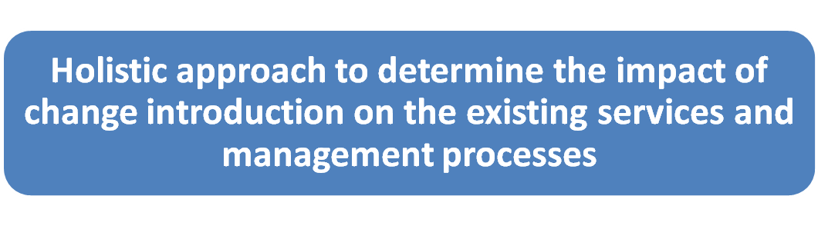
Service Design
How are we going to provide it?
How are we going to build it?
How are we going to test it?
How are we going to deploy it?

Slide 19
Processes in Service Design
Availability Management
Capacity Management
ITSCM (disaster recovery)
Supplier Management
Service Level Management
Information Security Management
Service Catalogue Management

Slide 20













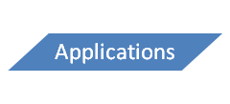
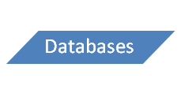
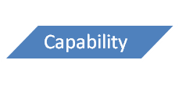

Service Catalogue
Keeps service information away from business information
Provides accurate and consistent information enabling service-focussed working

Slide 21
Service Level Management
Service Level Agreement
  Operational Level Agreements
    Internal
  Underpinning Contracts
    External Organisation
    Supplier Management
  Can be an annexe to a contract
  Should be clear and fair and written in easy-to-understand, unambiguous language
Success of SLM (KPIs)
  How many services have SLAs?
  How does the number of breaches of SLA change over time (we hope it reduces!)?

Slide 22
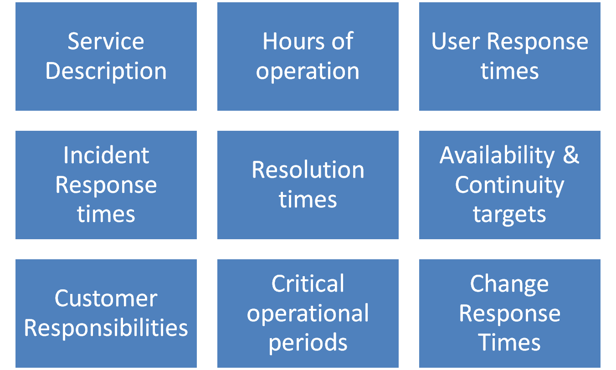
Things you might find in an SLA

Slide 23
Types of SLA
Service-based
  All customers get same deal for same services
Customer-based
  Different customers get different deal (and different cost)
Multi-level
  These involve corporate, customer and service levels and avoid repetition

Slide 24
Right Capacity, Right Time, Right Cost!
This is capacity management
Balances Cost against Capacity so minimises costs while maintaining quality of service

Slide 25
Is it available?
Ensure that IT services matches or exceeds agreed targets
Lots of Acronyms
  Mean Time Between Service Incidents
  Mean Time Between Failures
  Mean Time to Restore Service
Resilience increases availability
  Service can remain functional even though one or more of its components have failed

Slide 26
ITSCM – what?
IT Service Continuity Management
Ensures resumption of services within agreed timescale
Business Impact Analysis informs decisions about resources
  E.g. Stock Exchange can’t afford 5 minutes downtime but 2 hours downtime probably wont badly affect a departmental accounts office or a college bursary

Slide 27
Standby for liftoff...
Cold
  Accommodation and environment ready but no IT equipment
Warm
  As cold plus backup IT equipment to receive data
Hot
  Full duplexing, redundancy and failover

Slide 28
Information Security Management
Confidentiality
  Making sure only those authorised can see data
Integrity
  Making sure the data is accurate and not corrupted
Availability
  Making sure data is supplied when it is requested

Slide 29
Service Transition
Build
Deployment
Testing
User acceptance
Bed-in

Slide 30
Good service transition
Set customer expectations
Enable release integration
Reduce performance variation
Document and reduce known errors
Minimise risk
Ensure proper use of services
Some things excluded
  Swapping failed device
  Adding new user
  Installing standard software

Slide 31
Knowledge management
Vital to enabling the right information to be provided at the right place and the right time to the right person to enable informed decision
Stops data being locked away with individuals
Obvious organisational advantage

Slide 32
Data-Information-Knowledge-Wisdom
Data
Information
- who, what , where?
Knowledge
- How?
Wisdom
- Why?
Wisdom cannot be assisted by technology – it only comes with experience!
Service Knowledge Information Management System is crucial to retaining this extremely valuable information

Slide 33
Service Asset and Configuration
Managing these properly is key
Provides Logical Model of Infrastructure and Accurate Configuration information
Controls assets
Minimised costs
Enables proper change and release management
Speeds incident and problem resolution

Slide 34
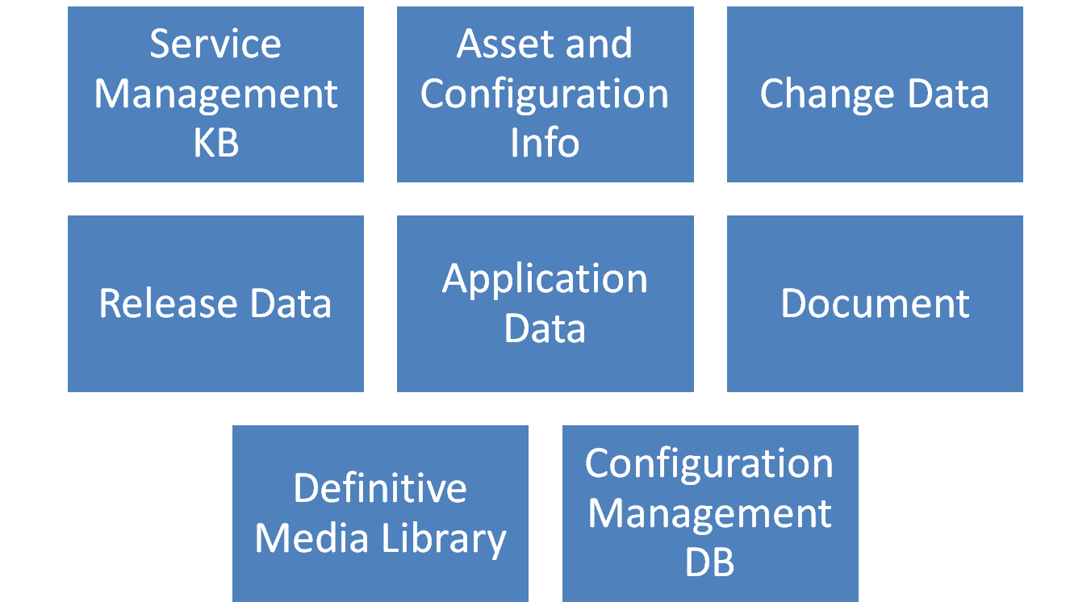
Configuration Management System

Slide 35
Painting the Forth Bridge...
A Baseline is a “last known good configuration”
But the CMS will always be a “work in progress” and probably always out of date. But still worth having
Current configuration will always be the most recent baseline plus any implemented approved changes

Slide 36
Change Management – or what we all get wrong!
Respond to customers changing business requirements
Respond to business and IT requests for change that will align the services with the business needs
Roles
  Change Manager
  Change Authority
    Change Advisory Board (CAB)
    Emergency CAB (ECAB)
80% of service interruption is caused by operator error or poor change control (Gartner)

Slide 37
Change Types
Normal
  Non-urgent, requires approval
Standard
  Non-urgent, follows established path, no approval needed
Emergency
  Requires approval but too urgent for normal procedure

Slide 38
Change Advisory Board
Change Manager (VITAL)
One or more of
  Customer/User
  User Manager
  Developer/Maintainer
  Expert/Consultant
  Contractor
CAB considers the 7 Rs
  Who RAISED?, REASON, RETURN, RISKS, RESOURCES, RESPONSIBLE, RELATIONSHIPS to other changes

Slide 39
Release Management
Release is a collection of authorised and tested changes ready for deployment
A rollout introduces a release into the live environment
Full Release
  e.g. Office 2007
Delta (partial) release
  e.g. Windows Update
Package
  e.g. Windows Service Pack

Slide 40
Phased or Big Bang?
Phased release is less painful but more work
Deploy can be manual or automatic
Automatic can be push or pull
Release Manager will produce a release policy
Release MUST be tested and NOT by the developer or the change instigator

Slide 41
Service Operation
Maintenance
Management
Realises Strategic Objectives and is where the Value is seen

Slide 42
Processes in Service Operation
Incident Management
Problem Management
Event Management
Request Fulfilment
Access Management

Slide 43
Functions in Service Operation
Service Desk
Technical Management
IT Operations Management
Applications Management

Slide 44
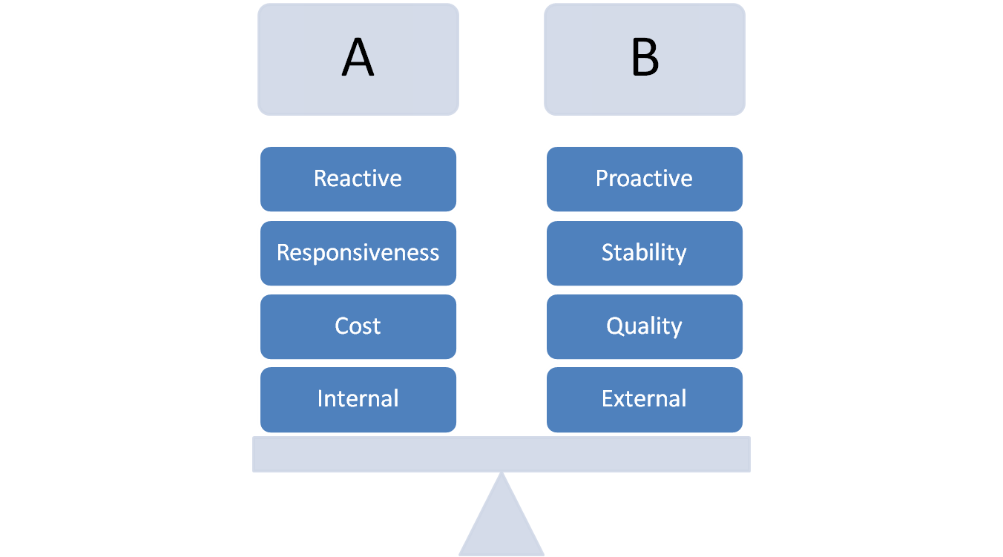
Service Operation Balances

Slide 45
Incident Management
Deals with unplanned interruptions to IT Services or reductions in their quality
Failure of a configuration item that has not impacted a service is also an incident (e.g. Disk in RAID failure)
Reported by:
  Users
  Technical Staff
  Monitoring Tools

Slide 46
Event Management
3 Types of events
  Information
  Warning
  Exception
Can we give examples?
Need to make sense of events and have appropriate control actions planned and documented

Slide 47
Request Fulfilment
Information, advice or a standard change
Should not be classed as Incidents or Changes
Can we give more examples?

Slide 48
Problem Management
Aims to prevent problems and resulting incidents
Minimises impact of unavoidable incidents
Eliminates recurring incidents
Proactive Problem Management
  Identifies areas of potential weakness
  Identifies workarounds
Reactive Problem Management
  Indentifies underlying causes of incidents
  Identifies changes to prevent recurrence

Slide 49
Access Management
Right things for right users at right time
Concepts
  Access
  Identity (Authentication, AuthN)
  Rights (Authorisation, AuthZ)
  Service Group
  Directory

Slide 50
Service Desk
Local, Central or Virtual
Examples?
Single point of contact
Skills for operators
  Customer Focus
  Articulate
  Interpersonal Skills (patient!)
  Understand Business
  Methodical/Analytical
  Technical knowledge
  Multi-lingual
Service desk often seen as the bottom of the pile
  Bust most visible to customers so important to get right!

Slide 51
Continual Service Improvement
Focus on Process owners and Service Owners
Ensures that service management processes continue to support the business
Monitor and enhance Service Level Achievements
Plan – do –check – act (Deming)

Slide 52
Service Measurement
Technology (components, MTBF etc)
Process (KPIs - Critical Success Factors)
Service (End-to end, e.g. Customer Satisfaction)
Why?
  Validation – Soundness of decisions
  Direction – of future activities
  Justify – provide factual evidence
  Intervene – when changes or corrections are needed

Slide 53
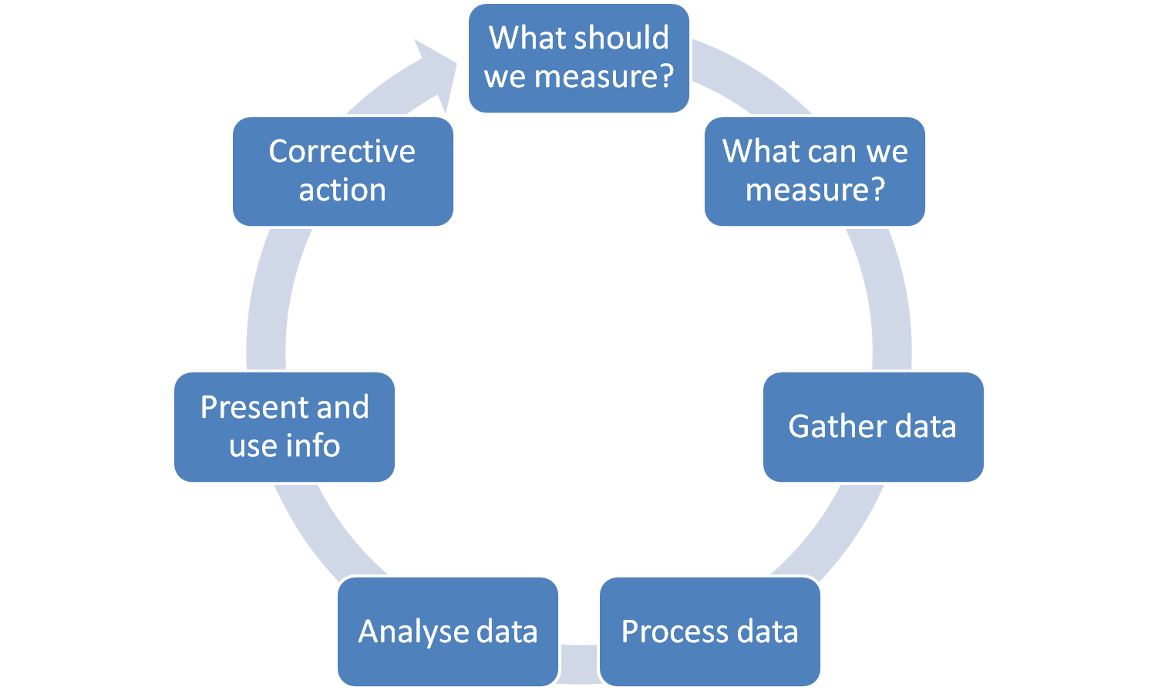
7 Steps to Improvement

Slide 54
ITIL Roles
Process Owner
  Ensures Fit for Purpose
Process Manager
  Monitors and Reports on Process
Service Owner
  Accountable for Delivery
Service Manager
  Responsible for initiation, transition and maintenance. Lifecycle!

Slide 55
More Roles
Business Relationship Manager
Service Asset & Configuration
  Service Asset Manager
  Service Knowledge Manager
  Configuration Manager
  Configuration Analyst
  Configuration Librarian
  CMS tools administrator

Slide 56
Functions and Processes
Process
  Structured set of activities designed to accomplish a defined objective
  Inputs & Outputs
  Measurable
  e.g. ??
Function
  Team or group of people and tools they use to carry out one or more processes or activities
  Own practices and knowledge body
  e.g. ??

Slide 57
Further Learning
Do a 3-day course
We’re running one here 30th Mar – 1st April
Many training companies run these courses
ITSMF provides the full books
Internet forums and Groups
  Linkedin Group
  FacebookGroup
  Both quite active
Video: http://cf.ilxgroup.com/itilv3pres/main.html

Slide 58
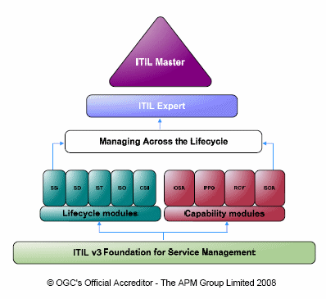
Accreditation
Today’s seminar is not accredited
3 days gives the foundation level
APM Group manages accreditation and certification
  BCS/ISEB is accredited by APM

